Slide 1
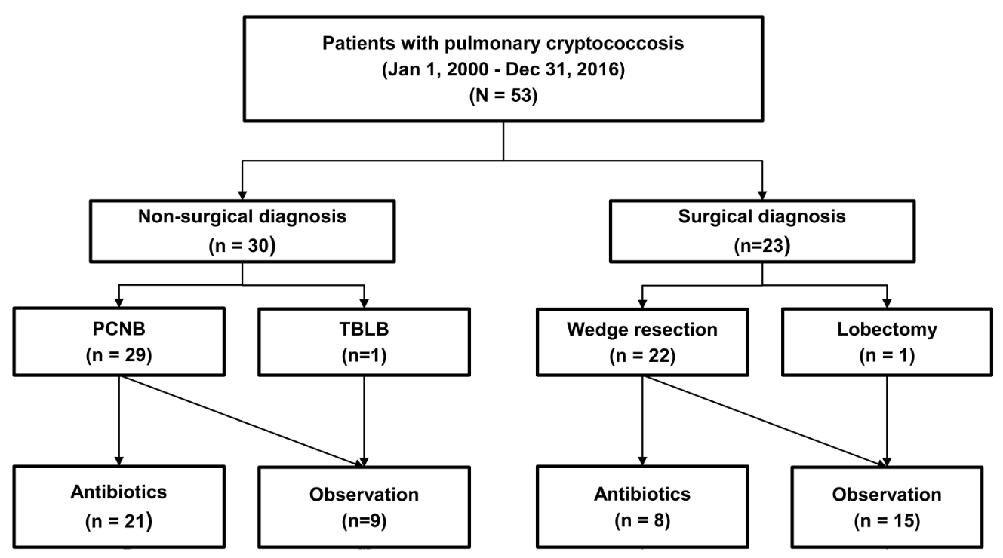
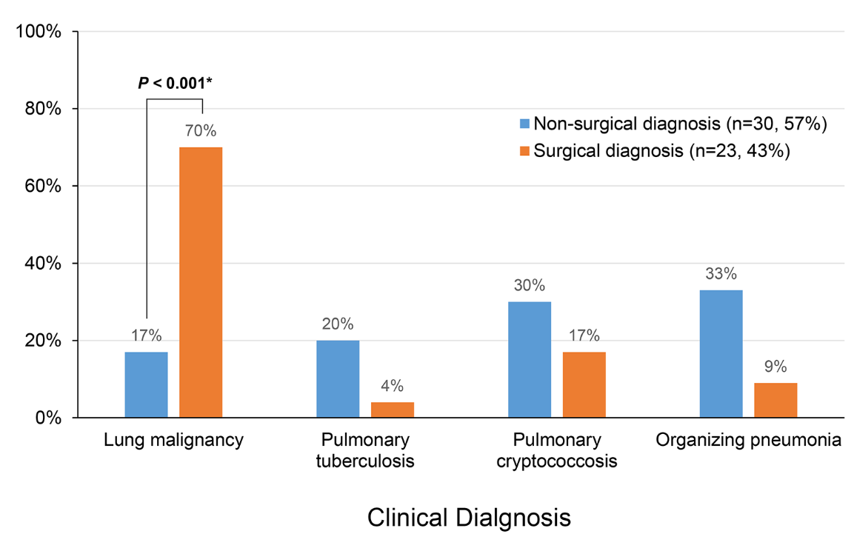
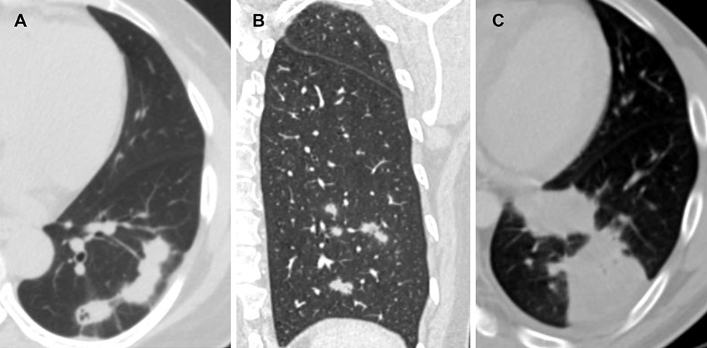
The Use of Surgery to Diagnose and Treat Pulmonary Cryptococcosis in Immunocompetent Patients
Bumhee Yang
Division of Pulmonary and Critical Care Medicine, Departments of Medicine, Chungbuk National University Hospital, Chungbuk National University College of Medicine, Cheongju, South Korea
Purpose
Results
Radiological Findings of 53 Patients With Pulmonary
Cryptococcosis
. Comparison of Clinical Characteristics and Treatment Responses Between Patients Diagnosed Surgically Who Did and Did Not Receive Additional Antibiotic Treatment
No specific recommendations for the treatment of pulmonary cryptococcosis (PC) diagnosed by surgical resection are available and it is unclear whether such patients require additional antibiotics.
Also, the natural disease course in such patients has not been well-documented.
We evaluated the role played by surgery in the diagnosis and treatment of PC in immunocompetent subjects.
Diagnostic and traetment flow
 | Total (n = 53,100%) | Non-surgical diagnosis (n = 30, 57%) | Surgical diagnosis (n = 23, 43%) | p Value
Radiologic findingsª
Main pattern
Nodular pattern
Scattered nodular | 16 (30) | 7/16 (44) | 9/16 (56) | 0.230
Clustered nodular | 14 (26) | 11/14 (79) | 3/14 (21) | < 0.001
Solitary pulmonary nodular | 15 (28) | 8/15 (53) | 7/15 (47) | 0.407
Solitary pulmonary mass | 2 (3) | 1/2 (50) | 1/2 (50) | 0.500
Bronchopneumonic pattern | 4 (8) | 3/4 (75) | 1/4 (25) | 0.051
Mixed pattern | 2 (3) | 0/2 (0) | 2/2 (100) | -
Other signs
Cavity | 13 (25) | 9/13 (69) | 4/13 (31) | 0.005
Mediastinal lymphadenopathy | 1 (2) | 0/1 (0) | 1/1 (100) | -
Air bronchogram | 15 (28) | 11/15 (73) | 4/15 (27) | < 0.001
Location
Peripheral | 36 (68) | 24/36 (67) | 12/36 (37) | < 0.001
Central | 1 (2) | 0/1 (0) | 1/1 (100) | -
Undetermined | 13 (25) | 4 /13 (31) | 9/13 (69) | 0.005
Multiple | 3 (6) | 2/3 (67) | 1/3 (33) | 0.255
 | Surgical resection (n = 15) | Antibiotic treatment after surgical resection (n = 8) | p Value
Radiologic finding (main pattern) |  |  | 0.907
Solitary pulmonary nodular | 5 (33) | 3 (38)
Solitary pulmonary mass | 1 (7) | 0 (0)
Scattered nodular | 5 (33) | 4 (50)
Clustered nodular | 2 (13) | 0 (0)
Multiple clustered nodular | 0 (0) | 0 (0)
Bronchopneumonic pattern | 1 (7) | 0 (0)
Mixed pattern | 1 (7) | 1 (12)
Treatment outcome |  |  | > 0.999
Improvement | 15 (100) | 8 (100)
Partial response or no change | 0 (0) | 0 (0)
Progression | 0 (0) | 0 (0)
Follow-up duration, months | 33.9 (15.1-52.2) | 45.0 (25.1-93.3) | > 0.999
Initial presumned clinical diagnosis in patients with pulmonary cryptococcosis
Methods
We retrospectively studied 53 immunocompetent patients who were pathologically diagnosed with PC between January 2000 and December 2016 in a tertiary referral center.
Compare the radiological presentations of, and diagnostic modalities used to evaluate, patients diagnosed both surgically and non-surgically.
Compare the treatment outcomes of patients who underwent surgical resection alone and those who received additional antibiotics following surgical resection
Baseline Characteristics of 53 Patients With Pulmonary
Cryptococcosis
 | Total (n = 53,100%) | Non-surgical diagnosis (n = 30, 57%) | Surgical diagnosis (n = 23, 43%) | p Value
Age, years | 57 (47-66) | 52 (43-63) | 64 (53-69) | 0.239
Sex, male | 35 (66) | 22 (73) | 13 (57) | 0.200
Current or ex-smoker | 28 (53) | 16 (53) | 12 (52) | 0.921
Comorbidities
Diabetes mellitus | 15 (28) | 6 (20) | 9 (39) | 0.125
Hypertension | 20 (38) | 6 (20) | 14 (61) | 0.002
History of Tuberculosis | 5 (9) | 2 (7) | 3 (13) | 0.431
Malignancy | 15 (28) | 3 (10) | 12 (52) | 0.001
Clinical symptoms
Cough | 14 (26) | 10 (33) | 4 (17) | 0.192
Sputum | 10 (19) | 7 (23) | 3 (13) | 0.342
Hemoptysis | 2 (4) | 1 (3) | 1 (4) | 0.848
No symptoms | 36 (68) | 18 (60) | 18 (78) | 0.158
(A) Clastered nodular pattern in a 52-year old female patient who was diagnosed via percutaneous needle biopsy, (B) Scattered nodar pattern in a 53-year old female who as dignosed via surgical resection, (C) Bronchopneumonic pattern in a 45-year old male who was diagnosed via percutaneous needle biopsy.
Comparison of Treatment Responses Between Non-Surgically Diagnosed Patients and Surgically Diagnosed Patients
Conclusions
Surgical resection was required in 43% patients to diagnose PC. An initial suspicion of a lung malignancy was associated with use of surgical diagnostic approaches. Surgical resection not only afforded reliable diagnoses but also effectively treated PC. There was no need for additional antibiotics after complete surgical resection.
 | Total (n = 53,100%) | Non-surgical diagnosis (n = 30, 57%) | Surgical diagnosis (n = 23, 43%) | p Value
Treatment outcome
Improvement | 45 (85) | 22 (73) | 23 (100) | 0.007
Partial response or no change | 7 (13) | 7 (23)^{b} | 0 (0)
Progression | 1 (2) | 1 (4)^{c} | 0 (0)
Follow-up duration | 29.4 (15.5-53.0) | 23.2 (13.3-59.0) | 33.1 (19.3-53.3) | 0.210

